Slide 1
Senior Project
Final Presentation
Summer 2016
VIP 3.0 Team Member(s): Vladan Lalovic, Johnatan Jensen, Michael Martinez, Daniel Lopez Product Owner(s): Masoud Sadjadi, Mohsen Taheri, Maral Kargarmoakhar
School of Computing and Information Sciences Florida International University

Slide 2
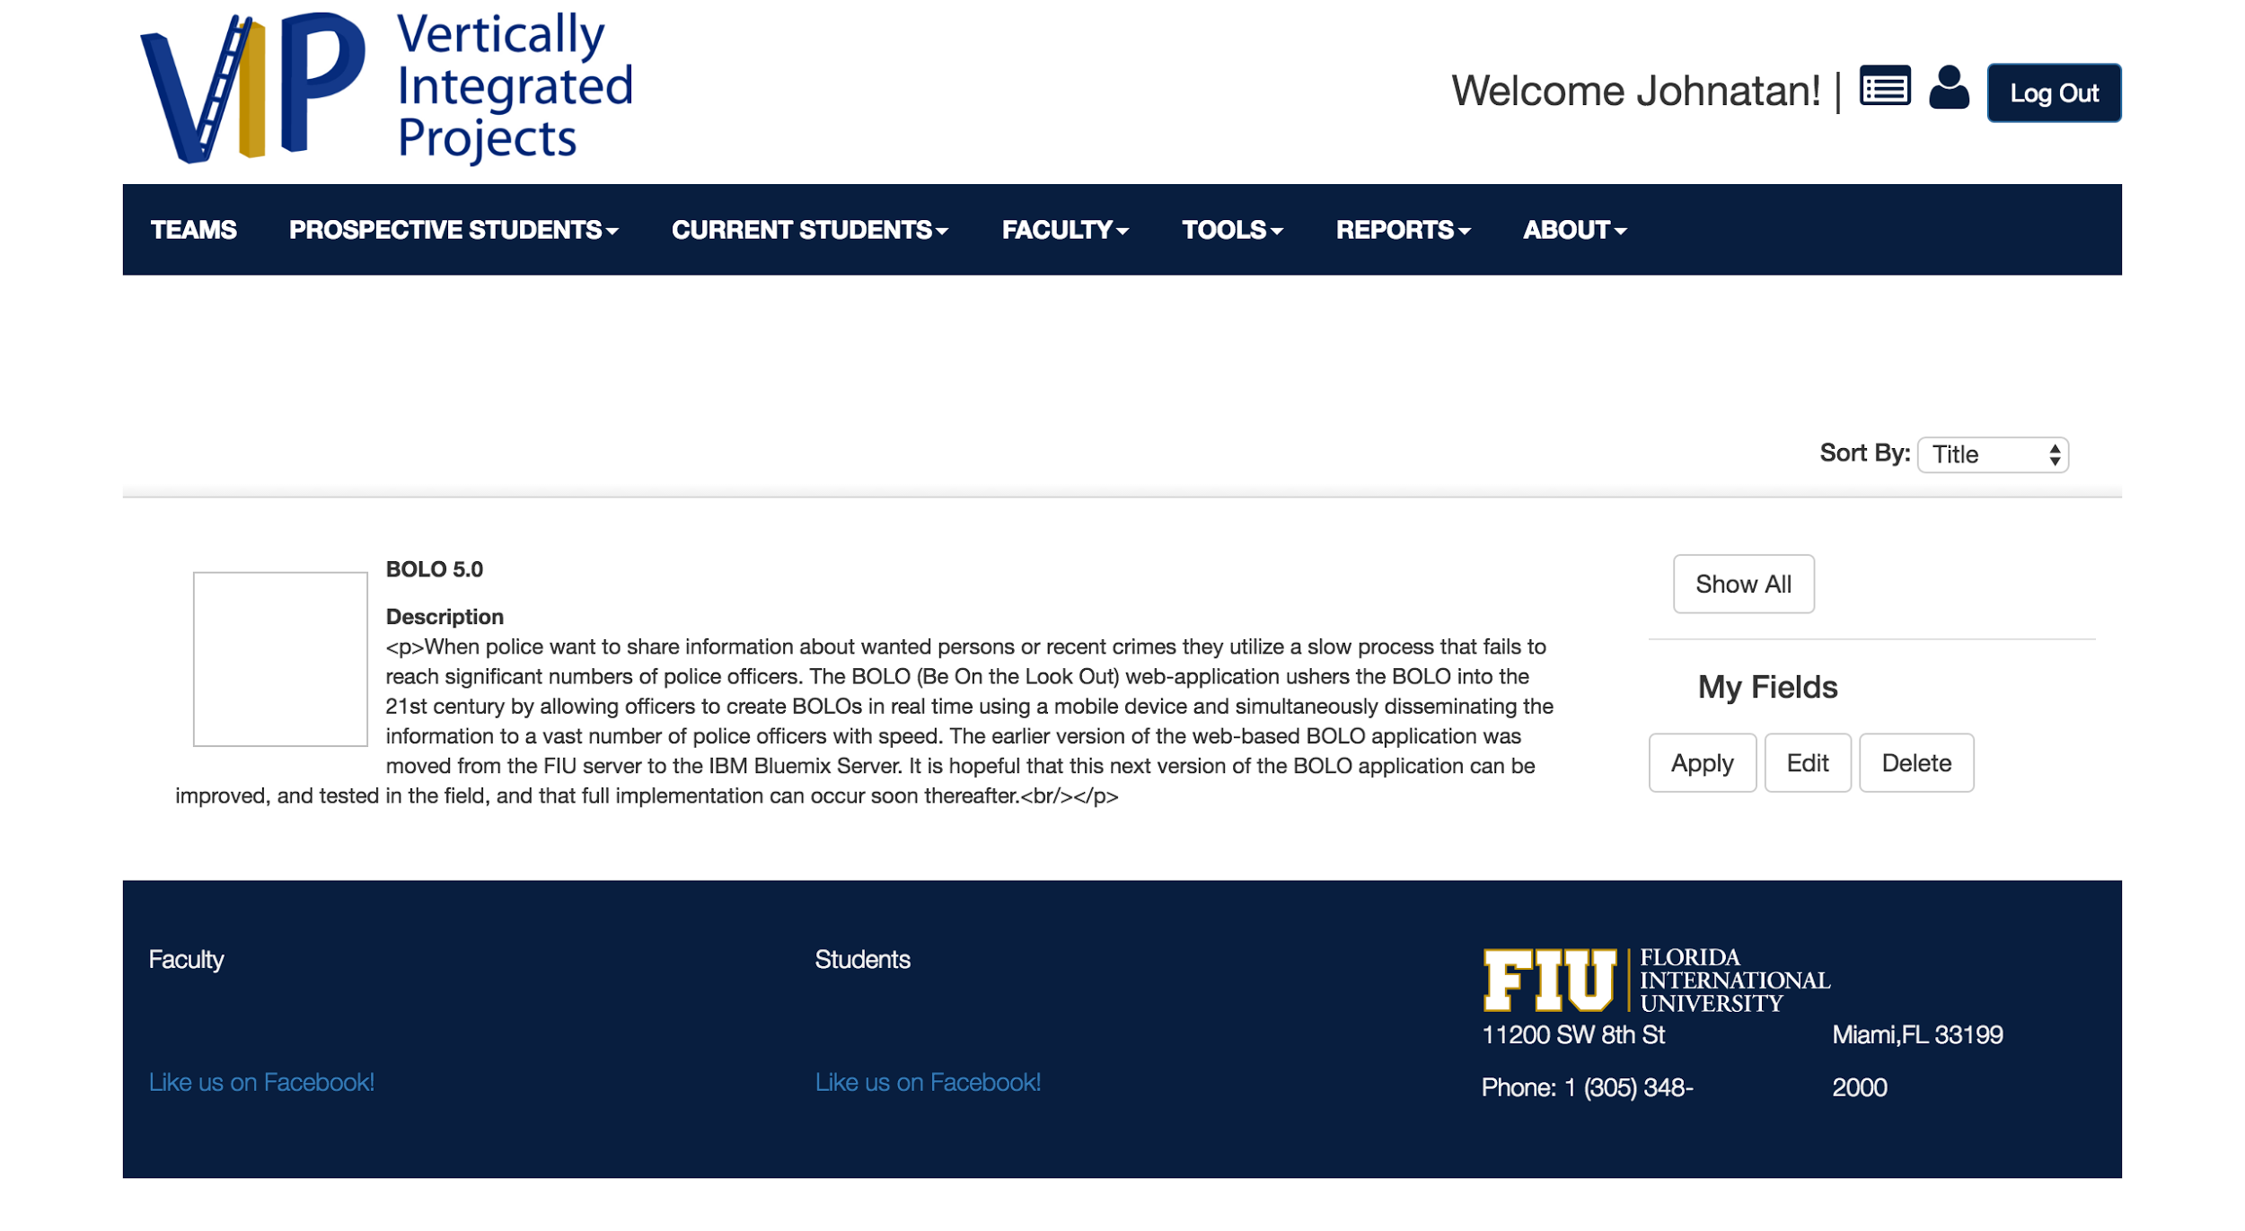
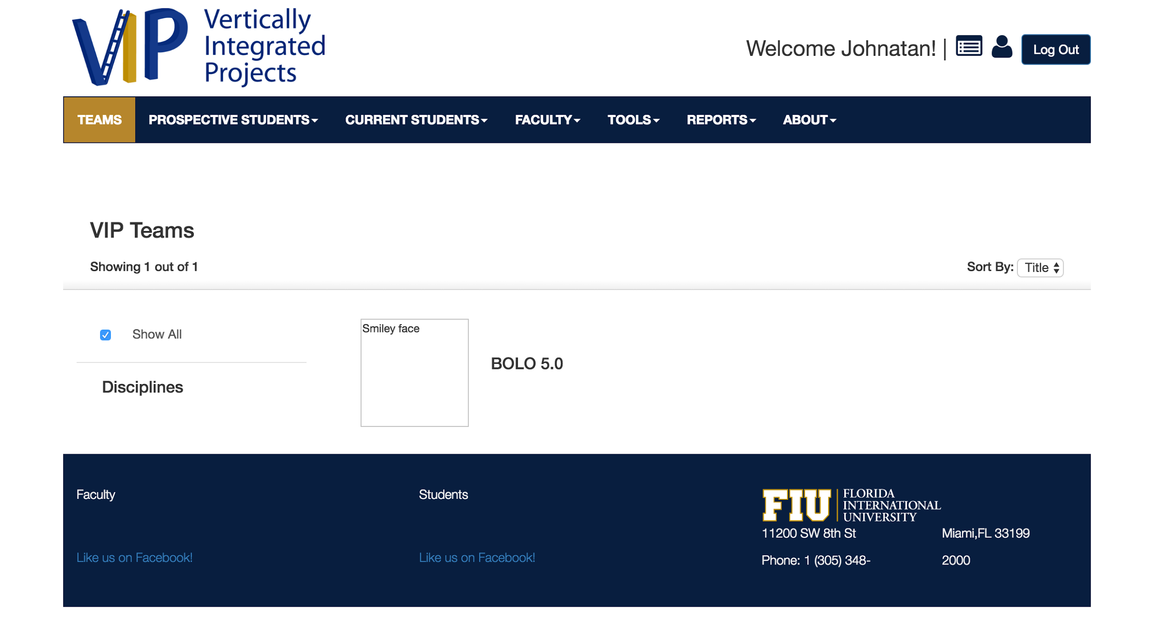
PROBLEMS OF VIP 2.0
Lacked main functionality
Mostly static
Not user friendly
No mobile responsiveness
Admin had no powers
Team focused on mobile judge

Slide 3
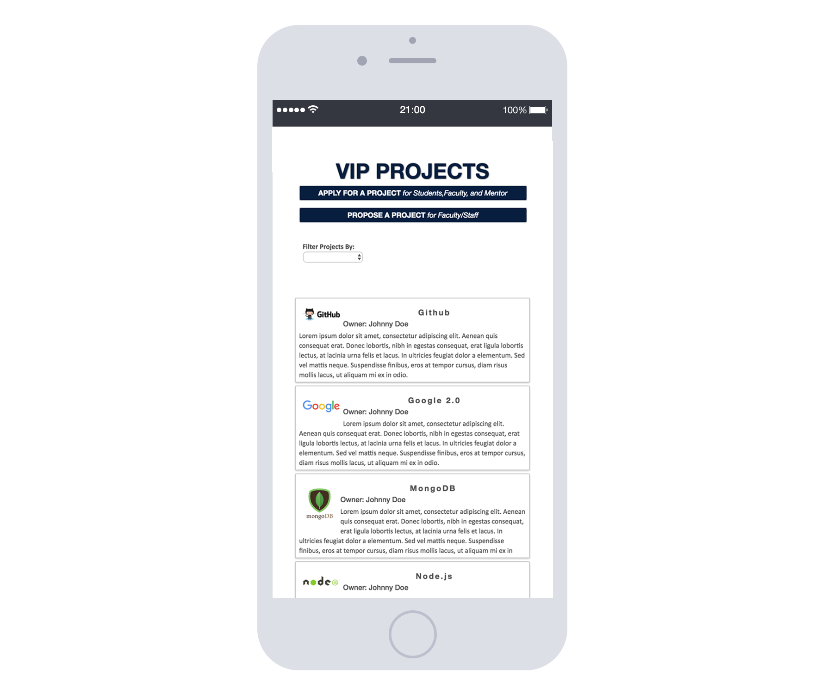
VIP TODAY

Slide 4
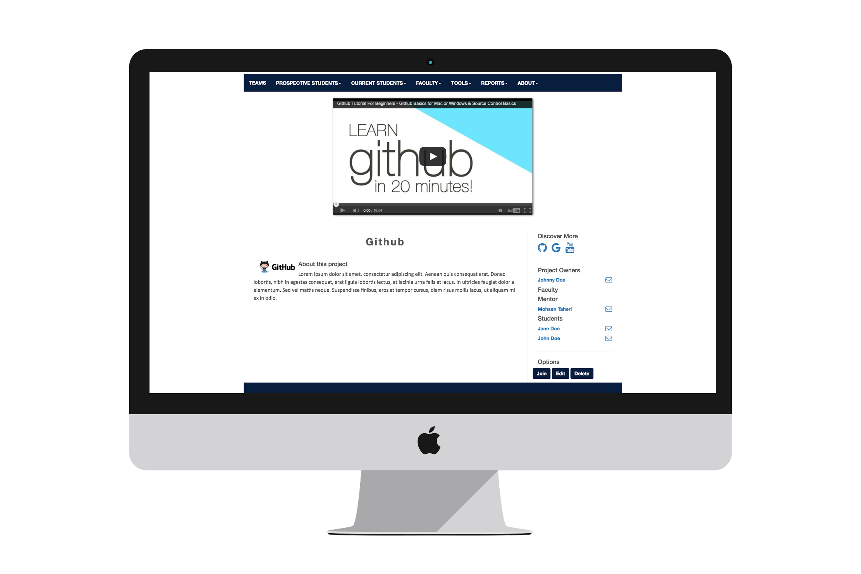
VIP TODAY

Slide 5
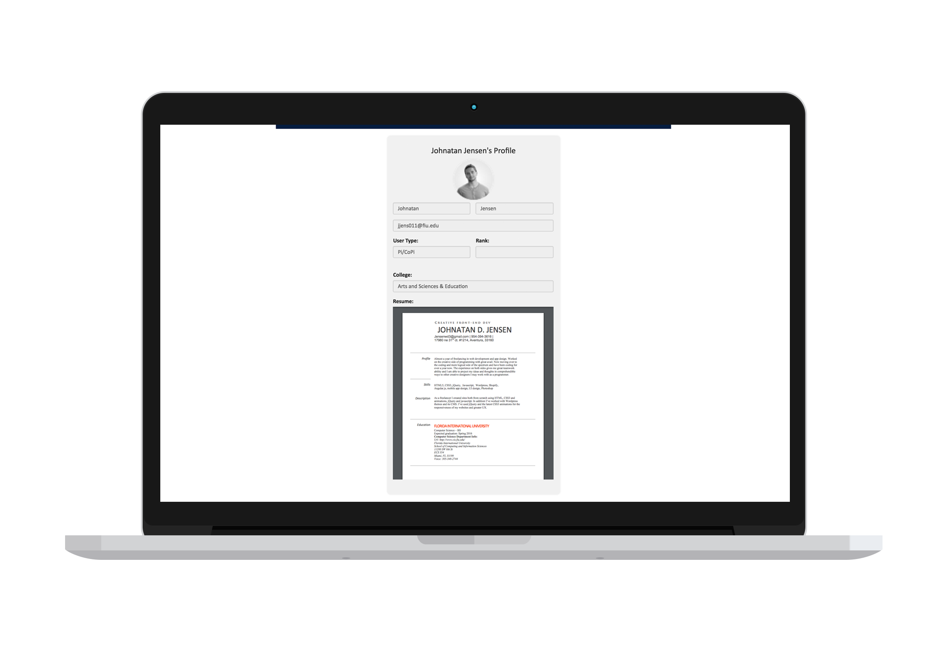
VIP TODAY

Slide 6
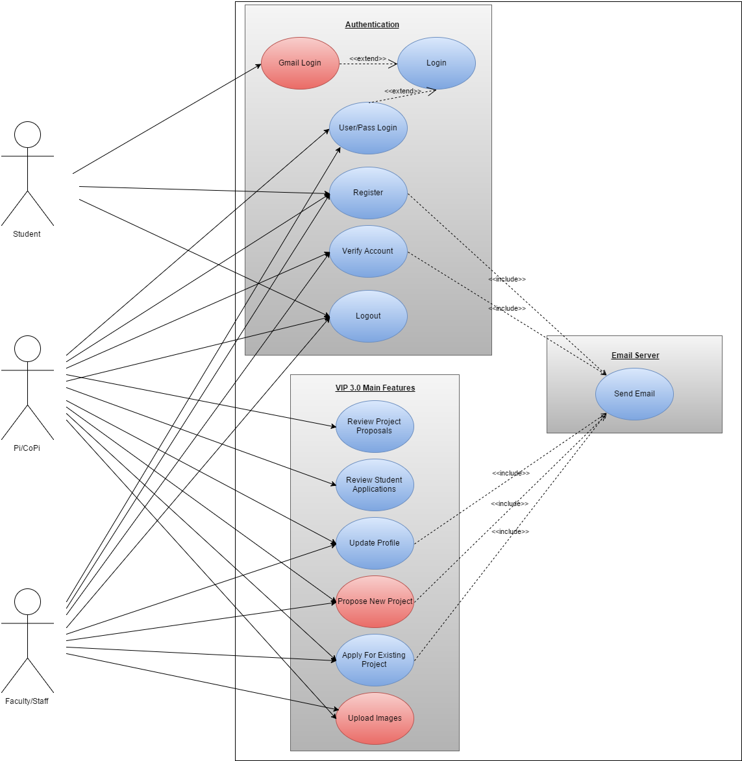
USE CASE DIAGRAM

Slide 7
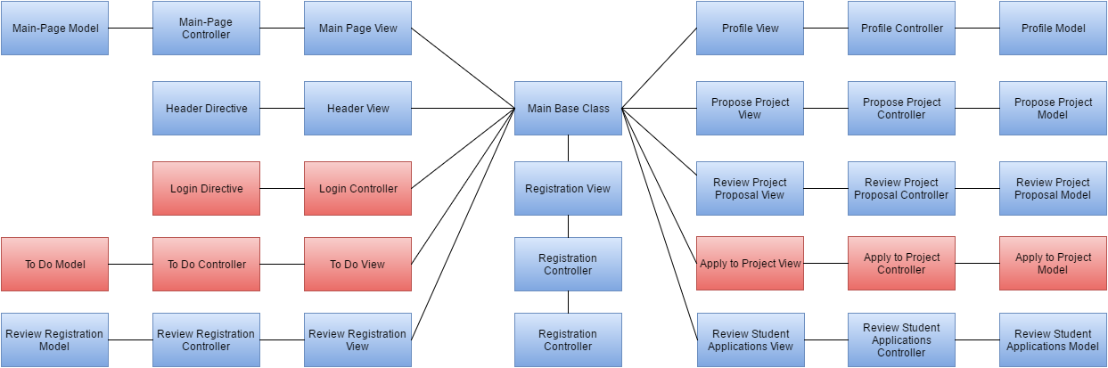
MINIMAL CLASS DIAGRAM

Slide 8
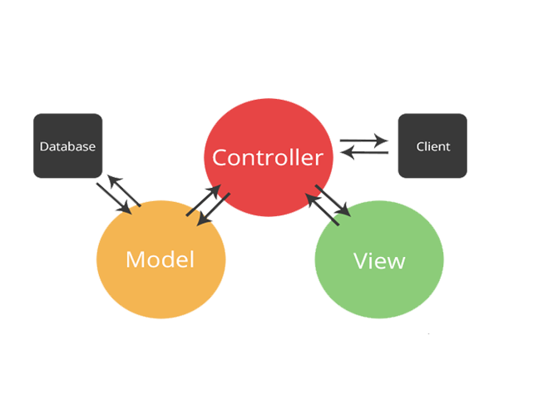

SYSTEM DESIGN: ARCHITECTURE
SOFTWARE
MVC
HARDWARE
CLIENT-SERVER

Slide 9
USER STORIES
Testing and modifying faculty project proposal process
Display Current User When Logged In
Create "Upload Image" functionality
Testing and Modifying To-Do
Edit Existing Projects By Faculty
Add Loading If Processes Are Loading In Background
Modify and update forget password.

Slide 10
Story Testing and modifying faculty project proposal process
BEFORE: Faculty proposal page was not implemented properly frontend and backend needed to be rewritten. NOW: Now faculty and can propose projects and even upload an image rather than paste a URL of an image.

Slide 11
Project PROFILES

Slide 12
Display Current User When Logged In
BEFORE: When you signed in you couldn’t know that you were signed in. NOW: The current username is displayed in the header when you sign in.

Slide 13
Display Current User When Logged In

Slide 14
Create Upload Image
BEFORE: When you proposed project you had to paste an image url. Now: You can upload an image with support for animated gifs.

Slide 15
Create Upload Image

Slide 16
Todo notifications
BEFORE: Todo notifications page was implemented but functionality was non-existent. NOW: Now VIP users can receive todo notifications which when paired email allows users to be informed greatly.

Slide 17
Edit existing project
BEFORE: Projects were set in stone. NOW: Now projects can now be edited they require pre-approval.

Slide 18
Add Loading If Processes Are Loading In Background
BEFORE: Projects were set in stone. NOW: Now projects can now be edited they require pre-approval.

Slide 19
Modify and update forget password
BEFORE: There was no way to recover accounts. NOW: Now user can recover forgotten accounts.

Slide 20
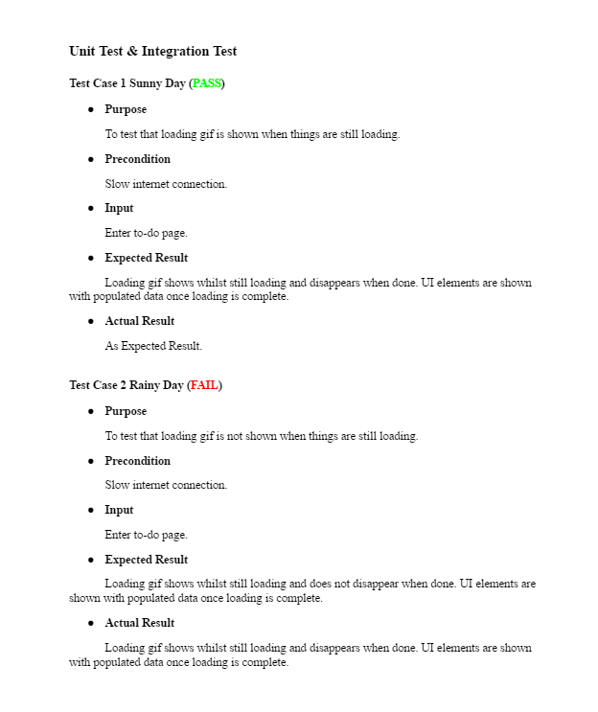
Test Case
Here I present a test case, one of many that shows that VIP development team prides itself in software testing.

Slide 21
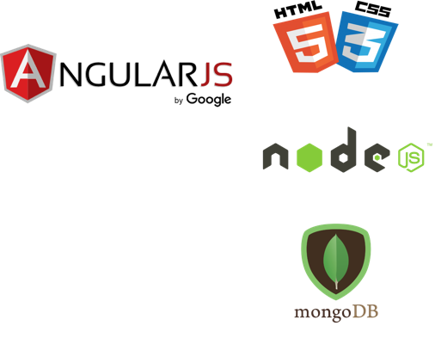

THANKS!
In short, the team behind VIP 3 has brought the web app to life and added it’s main functionalities. The experience is enjoyable and it will help connect faculty and students like never before
Any questions?
CONTACT | DLOPE073@FIU.EDU

